Slide 1
Attacks summary
Fast Gradient Sign Method (FGSM)
Jacobian-based Saliency Map Attack (JSMA)
DeepFool
Carlini and Wagner (C&W)’s attacks
Zeroth Order Optimization (ZOO)
…
Survey 1: https://arxiv.org/pdf/1712.07107.pdf
Survey 2: https://www.mdpi.com/2076-3417/9/5/909/htm#B17-applsci-09-00909

Slide 2
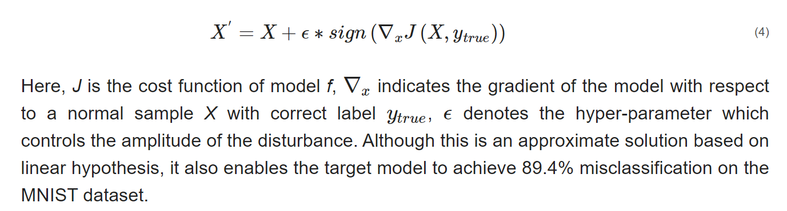
Fast Gradient Sign Method (FGSM)
Goodfellow et al. proposed a fast method called Fast Gradient Sign Method to generate adversarial examples
Survey 2: https://www.mdpi.com/2076-3417/9/5/909/htm#B17-applsci-09-00909

Slide 3
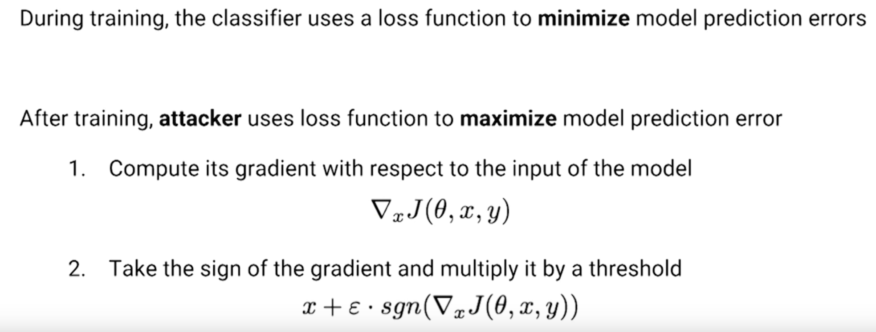
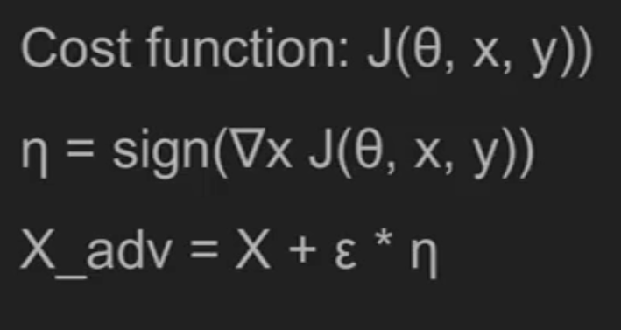
Fast Gradient Sign Method (FGSM)
Goodfellow et al. proposed a fast method called Fast Gradient Sign Method to generate adversarial examples
Source 1: https://www.youtube.com/watch?v=hUukErt3-7w
Source 2: https://av.tib.eu/media/34794

Slide 4
Jacobian-based Saliency Map Attack (JSMA)
directly provides the gradient of the output component relative to each input component, and the obtained knowledge is used in the complex saliency map method to produce the adversarial samples.
limits the l₀ norm of the perturbations, which means only a few pixels of the image need to be modified.
is especially useful for source/target misclassification attacks.
Survey 2: https://www.mdpi.com/2076-3417/9/5/909/htm#B17-applsci-09-00909

Slide 5
Jacobian-based Saliency Map Attack (JSMA)
Papernot et al.
Jacobian matrix: matrix of all partial derivatives of a function
defined two adversarial saliency maps to select the feature/pixel to be crafted in each iteration.
Use saliency map from Jacobian matrix with feature set to find two pixels to perturb with highest impact.
achieved 97% adversarial success rate by modifying only 4.02% input features per sample.
runs very slow due to its significant computational cost.
Papernot, N.; McDaniel, P.; Jha, S.; Fredrikson, M.; Celik, Z.B.; Swami, A. The limitations of deep learning in adversarial settings. In Proceedings of the 2016 IEEE European Symposium on Security and Privacy (EuroS&P), Saarbrucken, Germany, 21–24 March 2016; pp. 372–387.

Slide 6
DeepFool
Moosavi-dezfooli et al.
compute a minimal norm adversarial perturbation for a given image in an iterative manner, in order to find the decision boundary closest to the normal sample X and find the minimal adversarial samples across the boundary.
solved the problem of choosing the parameter ϵ under FGSM and carried out the attack against the general nonlinear decision functions by using multiple linear approximations.
demonstrated that the perturbations they generate are smaller than FGSM and have a similar deception rate.
Survey 2: https://www.mdpi.com/2076-3417/9/5/909/htm#B17-applsci-09-00909

Slide 7
DeepFool
find the closest distance from the original input to the decision boundary of adversarial examples
To overcome the non-linearity in high dimension, they performed an iterative attack with a linear approximation.
Starting from an affine classifier, they found that the minimal perturbation of an affine classifier is the distance to the separating affine hyperplan
An affine function is a function composed of a linear function + a constant and its graph is a straight line. The general equation for an affine function in 1D is: y = Ax + c.
https://arxiv.org/pdf/1511.04599.pdf

Slide 8
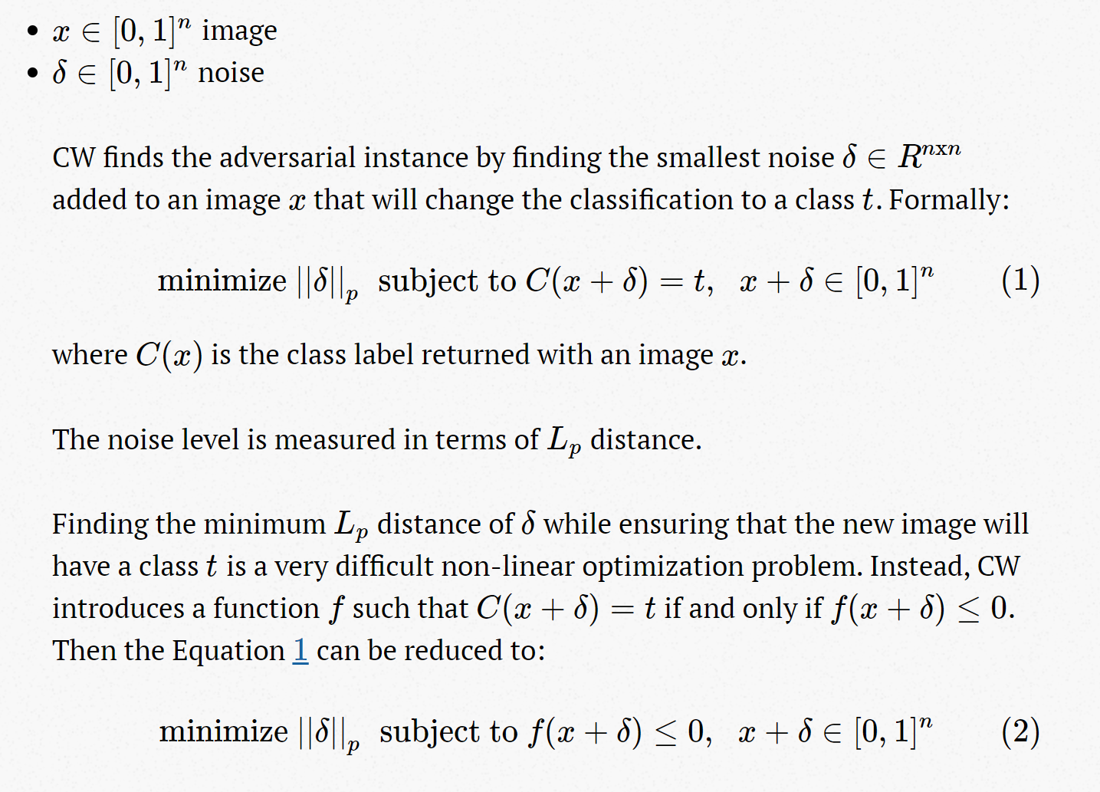
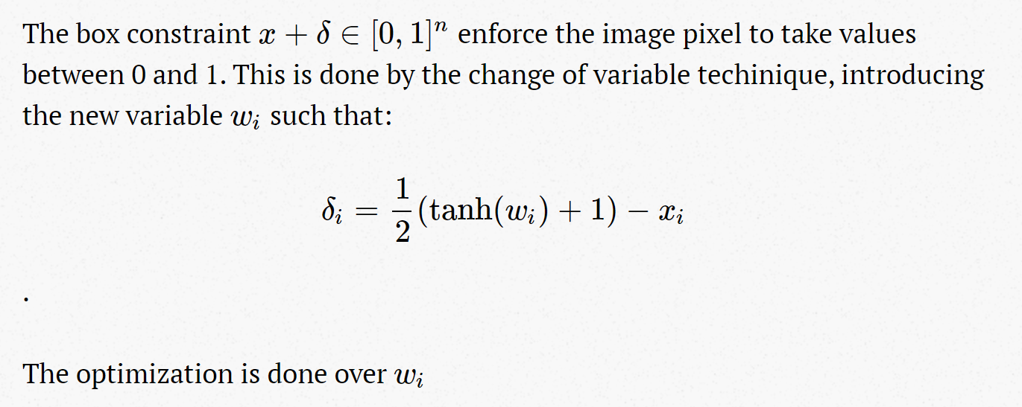
C&W’s attacks
Carlini and Wagner launched a targeted attack to defeat Defensive distillation
https://github.com/carlini/nn_robust_attacks
Nicholas Carlini and David Wagner, "Towards Evaluating the Robustness of Neural Networks”, IEEE Symposium on Security & Privacy, 2017.

Slide 9
C&W’s attacks
Carlini and Wagner launched a targeted attack to defeat Defensive distillation
https://github.com/carlini/nn_robust_attacks
https://fairyonice.github.io/Learn-the-Carlini-and-Wagners-adversarial-attack-MNIST.html#Box-constraints

Slide 10
Zeroth Order Optimization (ZOO)
Different from gradient-based adversarial generating approaches
does not require gradients, it can be directly deployed in a black-box attack without model transferring

Slide 11
Available open source libraries
Foolbox
Collection of different methods (JSMA, FGSM, DeepFool,…) supporting many different libraries (TensorFlow, Keras, Theano)
Cleverhans
DeepFool
FGSM
…

